Slide 1
Data with Kernel
Linear Decision Hyperplane
Kernel function
Dim 1
Dim 2

Slide 2
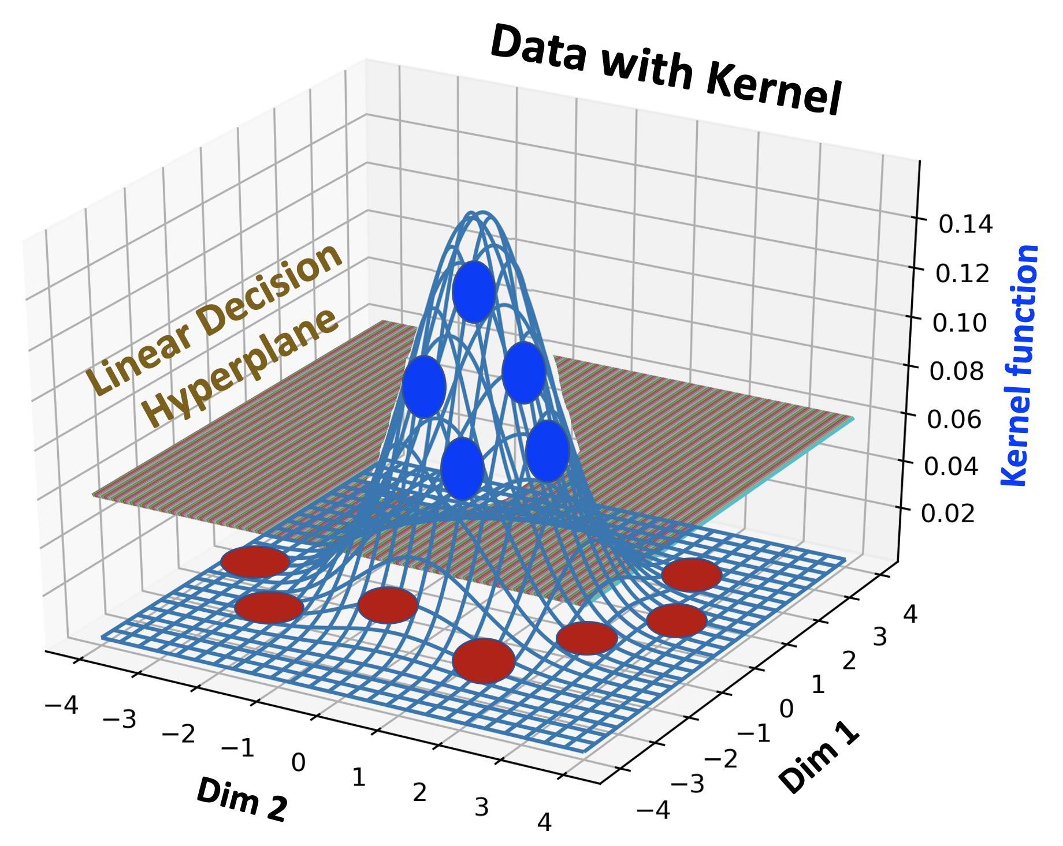
Original Data
There is no good linear decision boundary
Separation
Dim 2
Dim 2
Dim 1
Dim 1

